Slide 1
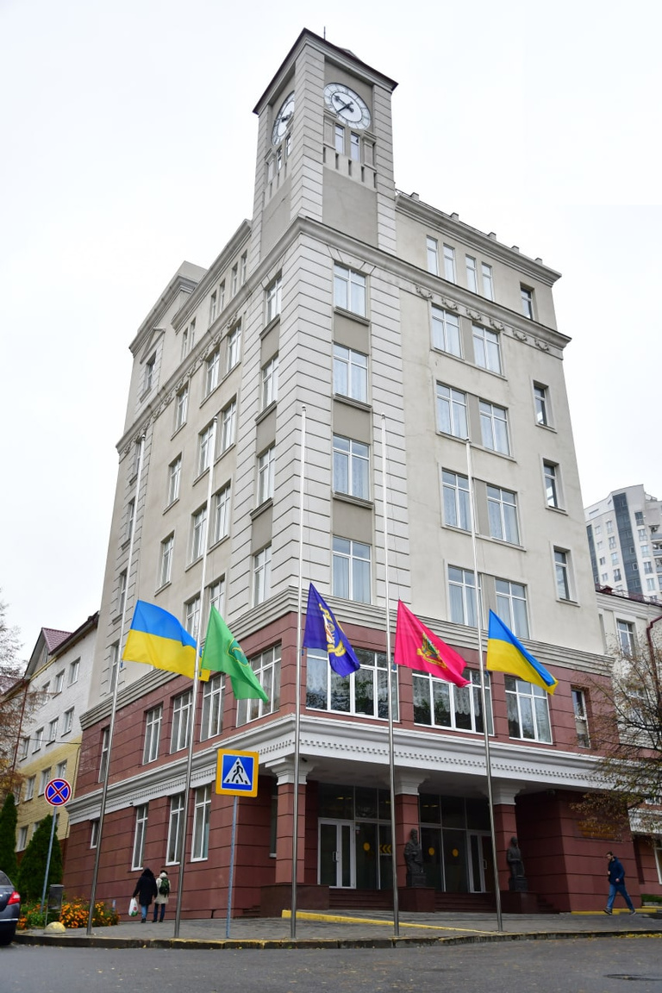



SIMON KUZNETS KHARKIV NATIONAL UNIVERSITY OF ECONOMICS

Slide 2
UNIVERSITY TODAY
  4 INSTITUTIONS
1 FACULTY
  29 DEPARTMENTS
  25 SPECIALTIES
  6 976 STUDENTS (including 780 international students)
  72 EDUCATIONAL PROGRAMS
  15 DOUBLE DEGREE PROGRAMMS
  5 EDUCATIONAL BUILDINGS
  1 FITNESS AND HEALTH CENTER
  7 STUDENTS DORMITORIES
  1 EDUCATIONAL LIBRARY BUILDING

Slide 3







Institute of Information technologies
Institute of Management and Marketing
Institute of Economy and Law
Institute of International Relations
Faculty of Training Foreign Citizens
Scientific and Educational Institutions and faculty of Simon Kuznets Kharkiv
National University of Economics

Slide 4












POSITION IN INTERNATIONAL RATINGS
1001-1500 rank in Times Higher Education Impact Rankings
601-800 rank in SDG 5 Gender Equality
601+ rank in QS Europe University Rankings
601-800 rank in SDG 8 Decent Work and Economic Growth
7204 rank in Webometrics Ranking of World Universities
801-1000 rank inSDG 8 Decent Work and Economic Growth
3792 rank in Google Scholar Top Universities by Citations in Top Google Scholar profiles
601-800 rank in SDG 10 Reduced Inequalities
601-800 rank in SDG 16 Peace, Justice and Strong Institutions
265-266 rank in Google Scholar Institutional Repositories by Google Scholar
1001-1500 rank in SDG 17 Partnerships for the Goals
Notes:
4

Slide 5








Simon Kuznets Kharkiv National
University of Economics participation
in International Organizations
Simon Kuznets Kharkiv National University of Economics since 2002 is a member of international foundations and associations:
  Magna Charta Universitatum (OMCU)
  European University Association (EUA)
  Francophone University Agency (AUF)
  Baltic University Program (BUP)
  Organization of Economic Co-operation and Development (OECD)
  International Association of Schools and Institutes of Administration (IASIA)
  Association of European Border Regions (AEBR)
  European Research Center for Information Systems (ERCIS)

Slide 6










Simon Kuznets Kharkiv National
University of Economics Centers
of International cooperation
  Austrian Center
  French Club
  Center for Ukrainian-Polish Academic Exchanges
  Center for Arabic Language Studies
  Center for University Success
  Ukrainian-Moroccan Center
  Ukrainian-Bulgarian Center
  European Union Information Center
  World Bank Innovation Knowledge Center
  AEPR Information Center
  Stem Laboratory
  MarkTech Laboratory
  Fab Lab

Slide 7





































Simon Kuznets Kharkiv National
University of Economics Foreign Partners

Slide 8





European University Alliance
The BAUHAUS4EU is a consortium of ten higher education institutions counting 124.000 students and 10.000 staff and collaborating closely in various innovative cooperation formats and channels shaping the future of teaching, learning, research and innovation.
International Grant Projects
The alliance consists of
  Bauhaus-Universität Weimar
  Blekinge Institute of Technology
  POLIS University
  Polytechnic University of Castelo Branco
  University of Architecture, Civil Engineering and Geodesy
  Université Lumière Lyon 2
  Université de Picardie Jules Verne
  Università Degli Studi di Bergamo
  University of Macedonia
  University of Economics in Katowice

Slide 9




Portuguese-Ukrainian Bachelor degree programme "International Business Management" with Politechnic Institute of Bragança (Portugal)
BACHELOR Degree Programs
with leading European Higher Education Institutions
Austro-Ukrainian Bachelor Degree Program of two diplomas «Management, Global Sales and Marketing» with University of Applied Sciences Upper Austria (Steyr, Austria)
Polish-Ukrainian Bachelor's program "Management" with WSB University, Dabrowa Gornicza (Poland)
Polish-Ukrainian Bachelor's program "Business psychology" with University of Public and Individual Security "Apeiron" in Krakow (Poland)

Slide 10


French-Ukrainian Master degree program "Business-informatics" with Lion-2 University (France)
MASTERS Degree Programs
with leading European Higher Education Institutions
Lithuanian-Ukrainian program of two diplomas of master's degree in public administration (Master of Public Administration) with the University of Mykolas Romeris, Vilnius (Lithuania)
Polish-Ukrainian Double Degree Program for Masters in "Event Management" with Nicolaus Copernicus University in Torun (Torun, Poland)
Italian-Ukrainian master degree program of double diplomas "Global Economy and Business", "International Business" with Italian university UNICAS

Slide 11

Polish-Ukrainian Master Degree Program
of two diplomas "Human Resources Management", "Social Security" with University of Public and Individual Security "Apeiron" in Krakow (Poland)
MASTERS Degree Programs
with leading European Higher Education Institutions
Joint Slovak-Ukrainian Master degree program "Business-analitics and information systems in entrepreneurship" with the School of Economics and Management of Public Administration in Bratislava (Slovak republic)
British-Ukrainian Master degree program "MBA: Organisational Transformations" with two pathways: “MBA in Organisational Transformations with Sustainability” “MBA in Organisational Transformations with Cybersecurity” with the Abertay University (Scotland)

Slide 12


Joint Polish-Ukrainian Master's Degree Program "Two Diplomas - 2D!" with University of Occupational Safety Management in Katowice (Poland)
MASTERS Degree Programs
with leading European Higher Education Institutions
Joint program MBA with MRU (Vilnius, Lithuania) for master students of “International IT-management”
Polish-Ukrainian Double Degree Program for Masters in "International business" with WSG (Bydgosch, Poland)
Double degree program for masters “Business Administration” with ISMA University (Riga, Latvia)

Slide 13



Digital University - Open Ukrainian Initiative
International Grant Projects
The project proposes to start the process of creating a full-fledged, integrated, sustainable, enriching, inclusive and high-performing digital educational ecosystem in Ukraine.
KA2
Providing of Academic Freedom and Inclusion through Digitalization
Project goal to enhance academic freedom and inclusion of students and teachers through establishing and exploiting of multi-institutional inclusive virtual campus (MIIVC), approachable to different kinds of users and focused on wide international optionality of digital educational courses

Slide 14

Agriculture Circular Economy – EXpert
International Grant Projects
The project creates a new figure of the Circular Economy Expert in the agricultural and industrial sectors, a professional with multidisciplinary training to guide agricultural and industrial enterprises towards more sustainable and environmentally friendly practices.
PubCirEco
KA2
Critical role of PUBlic employees in CIRcular ECOnomy implementation: Embedding circular economy thinking in HEIs
The PubCirEco project is designed to enhance the competencies and expertise of students and highly qualified professionals who are or will be employed in the public sector or private enterprises.

Slide 15

Stepping-up Entrepreneurship, Creativity and Intercultural Competences for High Quality Teaching in Ukraine
International Grant Projects
The project is an innovative project that aims at improving the competences of teachers and trainers in Ukrainian higher education institutions to enhance global entrepreneurial capacities and creativity to future students by developing a teacher training program using game-based and collaborative learning methodologies and creating open micro-certified short learning programs in order to better match labour market needs and to improve the level of competences, skills, employability potential and global entrepreneurial spirit of HEI students and the general public (VET).
KA2

Slide 16

Implementation of the European approach of Compliance Management in higher education in Ukraine
International Grant Projects
The project’s central focus is the implementation of the European approach to Compliance Management, with a strategic aim to elevate academic integrity, international management, entrepreneurship, business ethics and legal aspects in less experienced Ukrainian HEIs. The initiative responds to the pressing need for ongoing global and European integration and envisions substantial contributions to the recovery and future efficiency of Ukrainian businesses.
KA2

Slide 17



EU Cyber Standardization Strategy for Connectivity and Digital Infrastructure: Experience for Ukraine
International Grant Projects
The project aims to empower students and stakeholders by strengthening their practical experience in cybersecurity and artificial intelligence (AI) standards, with a particular focus on promoting European integration.
Financial system institutional transformations in era of digital economics: EU experience for Ukraine
The project is designed to spread the European experience of financial decentralization, financial security and digitalization of the financial sector and to develop of digital financial skills among students and business representatives in the context of digital transformation and adaptation to the modern needs of the European business environment.

Slide 18

Digital trade transformation: EU experience for Ukraine
International Grant Projects
The project is an interdisciplinary module, which will allow the new generation of students and all stakeholders to expand their practical knowledge about digital transformations in economy in various spheres of society in order to adapt management companies to the modern needs of the European business environment and for sustainable development of integration between the European Union and Ukraine.

Slide 19
CLIDE
Intercultural Leadership in the Digital Era
Erasmus Mundus Desigh Measures
The project is an interdisciplinary module, which will allow the new generation of students and all stakeholders to expand their practical knowledge about digital transformations in economy in various spheres of society in order to adapt management companies to the modern needs of the European business environment and for sustainable development of integration between the European Union and Ukraine.

Slide 20

Erasmus Mundus Program
Since 2018, Simon Kuznets Kharkiv National University of Economics has been an associate partner of the European Consortium of Masters in Law and Economics (EMLE), which has been repeatedly selected by the European Commission in the prestigious Erasmus Mundus program: Erasmus+
EMLE (European Master in Law and Economics) is a field of training that includes jurisprudence and economics combined with academic mobility. It is a separate student exchange program that undergoes accreditation every 5 years to continue to be included in the Erasmus Mundus Joint Master Degrees.

Slide 21



EU STUDY DAYS IN UKRAINE
International Grant Projects
EU Study Days in Ukraine is a project of the Representation of the European Union in Ukraine, and provides an opportunity for high school students, students and postgraduates to learn more about the European Union and relations between the EU and Ukraine from key European and Ukrainian experts in this field.
PARTNERS
Youth Alternative NGO (Kyiv)
Simon Kuznets Kharkiv National University of Economics
Ivan Franko National University of Lviv

Slide 22


Creative Spark: High Education Enterprise supported by British Council
PARTNERS
  University of Bedfordshire (Luton, UK)
  Simon Kuznets Kharkiv National University of Economics
  Ukrainian Engineering Pedagogics Academy
  Innovation Generation, NGO, (Kharkiv, Ukraine)
International Grant Projects
DEVELOPMENT OF SOCIAL ENTREPRENEURSHIP AT THE UNIVERSITY
  Université de Lorraine, France
  Greta du Velay, France
  NGO Gwara Media, Kharkiv
  Kharkiv Non-Profit Non-Governmental Organization ACTUAL WOMAN
  Entrepreneur Voitenko, graduate of the double degree program of KhNUE-Lyon 2
  IT Cluster Kharkiv
PARTNERS

Slide 23

A Career Roadmap for Women’s Leadership in Higher Education in Ukraine
The project aim is to create a stronger, more inclusive, international system of higher education, technical, professional education and training. The project plans to build relationships and share good practice with international partners to help higher education institutions and not-for-profit research organizations in the UK and Ukraine initiate systemic change to overcome the problem of under-representation of women in leadership positions in higher education.
International Grant Projects
PARTNERS
  University of Bedfordshire
  Education and Research Institute "Ukrainian Engineering and Pedagogics Academy" of V. N. Karazin Kharkiv National University
  Non-governmental Organisation “Innovation Generation”

Slide 24






ERASMUS+ TEMPUS IV project “SUCSID - Inter-university Start-up centers for students’ innovations development & promotion”
ERASMUS+ HORIZON 2020 EQUAL-IST project “Gender Equality Plans for Information Sciences and Technology Research Institutions”
IMPLEMENTED PROJECTS
ERASMUS+ project: Development of a network infrastructure for youth innovation entrepreneurship support on fablab platforms

Slide 25


ERASMUS+ JEAN MONNET project Democratic Decentralization as European Experience of Public Governance
ERASMUS+ project Establishing Modern Master-level Studies in Information Systems
IMPLEMENTED PROJECTS

Slide 26



ERASMUS+ KA2: Implementation of Education Quality Assurance system via cooperation of University- Business- Government in HEIs /EDUQAS
ERASMUS+ KA2: Structuring cooperation in doctoral research, transferrable skills training, and academic writing instruction in Ukraine's regions
IMPLEMENTED PROJECTS
ERASMUS+ KA2: Promoting internationalization of research through establishment and operationalization of Cycle 3 Quality Assurance System in line with the European Integration

Slide 27



THE PROJECT “FAU-HELP: FAU DIGITAL EDUCATION HELPING UKRAINE”
THE PROJECT: "DIGITAL UKRAINE: ENSURING ACADEMIC SUCCESS DURING THE CRISIS 2022"
IMPLEMENTED PROJECTS
THE PROJECT "JOUKRAINE - JOINT ONLINE EDUCATION WITH KHARKIV UNIVERSITIES (UKRAINE)"

